Slide 1
Module 03
DC power transmission

Slide 2
Converter
Converter
Inverter
Rectifier

Slide 3
Converter
Load Flow Definition
Positive load is defined for Inverter Case (generator convention)
In USA a common used term is “Inverter Based Resources” (IBR)
IBR are not only HVDC systems but all kind of generators such as:
Wind Turbine Generators (WTG)
PV
...
An VSC-HVDC system can be an inverter and a rectifier depending on the power flow direction, in some applications the change of direction is necessary

Slide 4
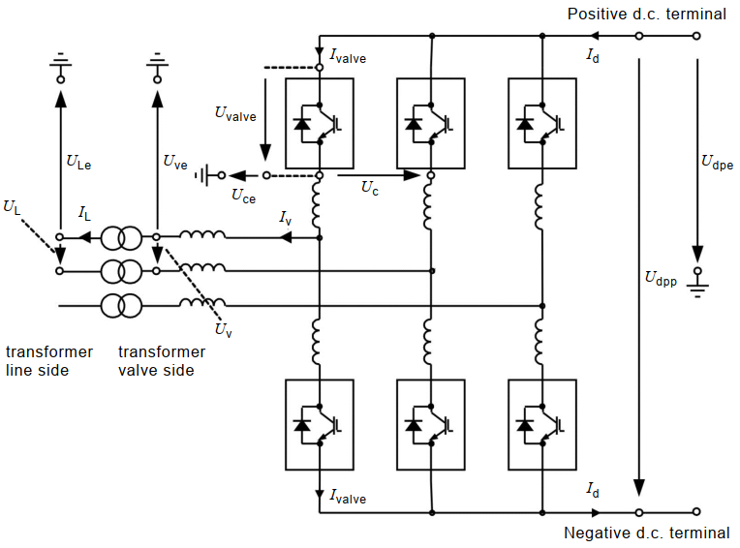
Converter Terminology IEC 62747:2014

Slide 5

DC Load Flow Definitions
DC equipment (incl. DC line) voltage is defined by the voltages $U_{dpe_rec}$ and $U_{dpe_inv}$
Converter sizing is defined by $U_{dpp_rec}$
HVDC systems have bidirectional transmission capability, which means that every individual converter can be either rectifier or inverter

Slide 6

Monopole
DC Definitions
$$U_{DC_Rec}=U_{dHP_Rec}$$
$$I_{DC}=\frac{U_{DC_Rec}−U_{DC_Inv}}{2∙R_{DC}}$$
$$U_{dHN_Inv}=I_{DC}∙R_{DC}$$
Max. voltage created by converter: $U_{DC_Rec}$
Max. equipment voltage: $U_{DC_Rec}$
DC cables have different voltage rating

Slide 7
Monopole
Extending power transmission of the system
Higher DC voltage
Limited equipment availability
Reliability
Higher DC current
Higher DC transmission line costs
Reliability
Installing additional monopole
Additional converter equipment
4 DC conductors
Reliability

Slide 8
Monopole → Bipole (BIP)
Bipole

Slide 9
Bipole (BIP)
3 conductors with 2 different types
Bipole consists of two-poles which can transmit the power independently
In case of a fault in one pole, the other pole can still transmit power providing redundancy in power transmission
In case of symmetrical operation (both poles transmit the same power), no current is flowing through the DMR

Slide 10
BIP operation modes
Bipolar operation – Balanced mode
Poles are running with at the same power
No current is running through the DMR
Losses optimized operation
Monopolar operation
Emergency mode operation
System design relevant
Bipolar operation – Unbalanced mode
Split-Busbar
Current running through the DMR in case of different power flow in the AC Grid
Reduced redundancy

Slide 11
DC Load Flow
For DC load Flow calculation the converter can be represented as an ideal voltage source

Slide 12
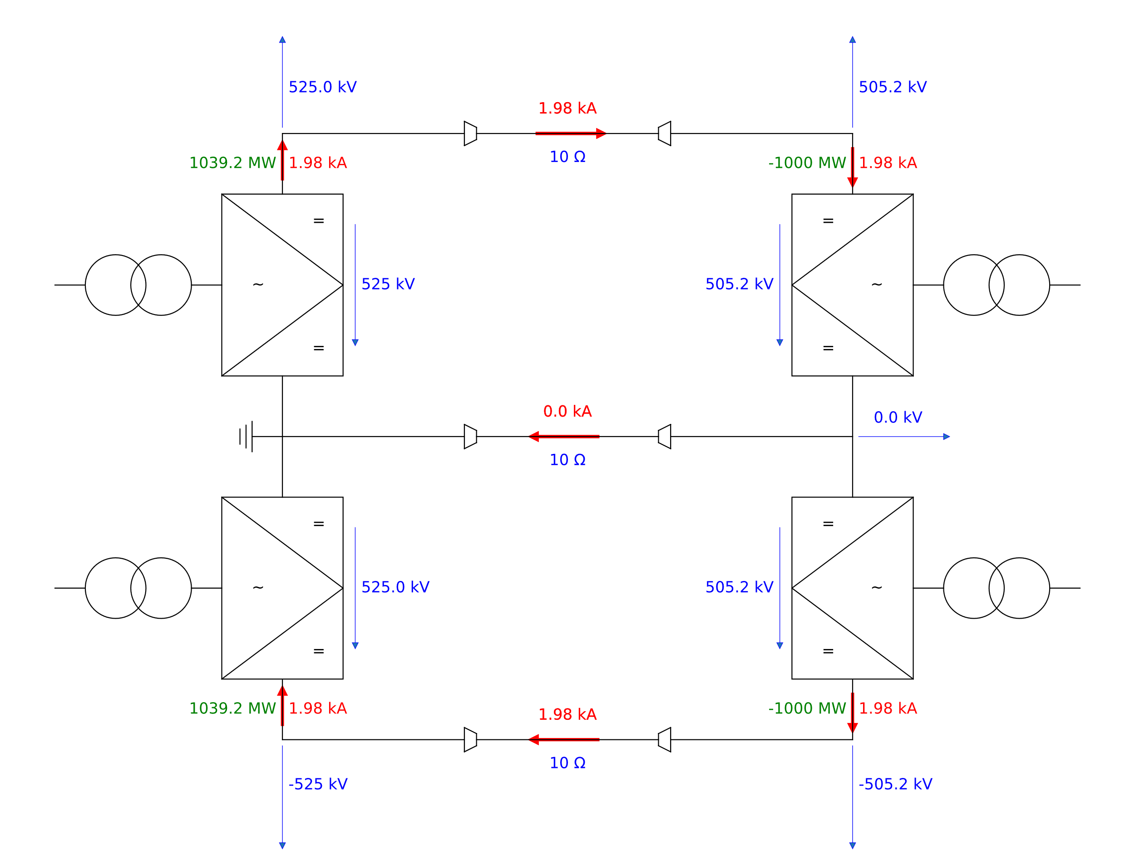
Balanced Operation

Slide 13
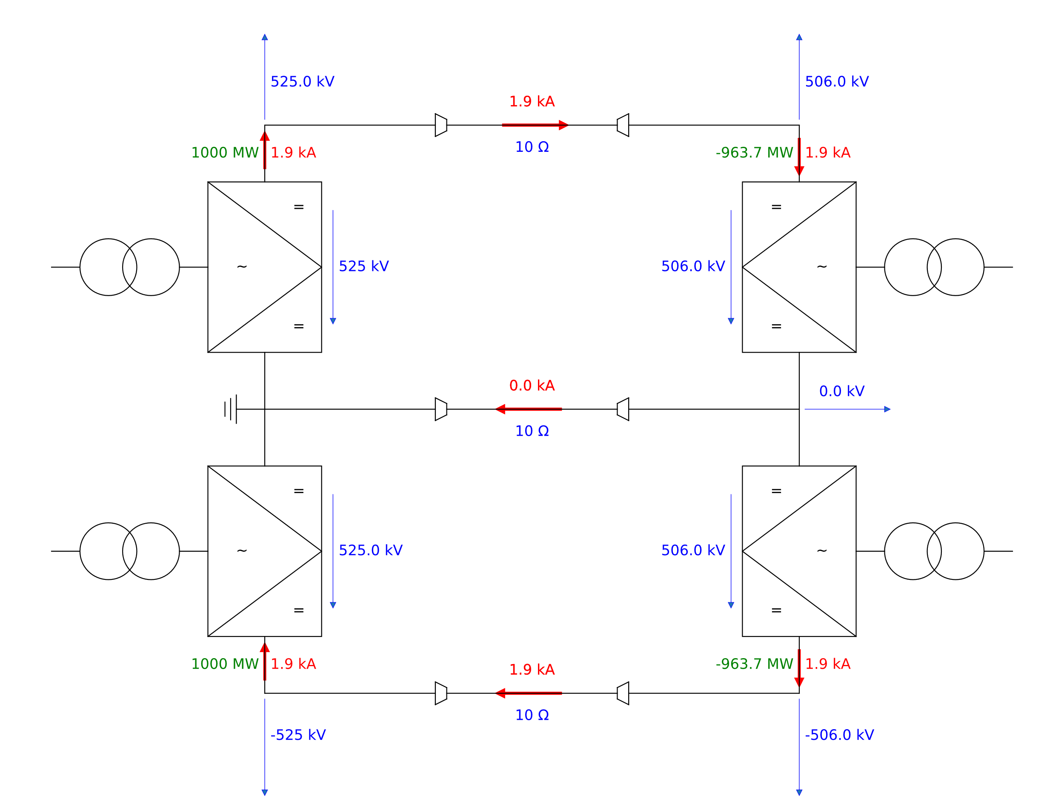
Balanced Operation: Power Definition

Slide 14
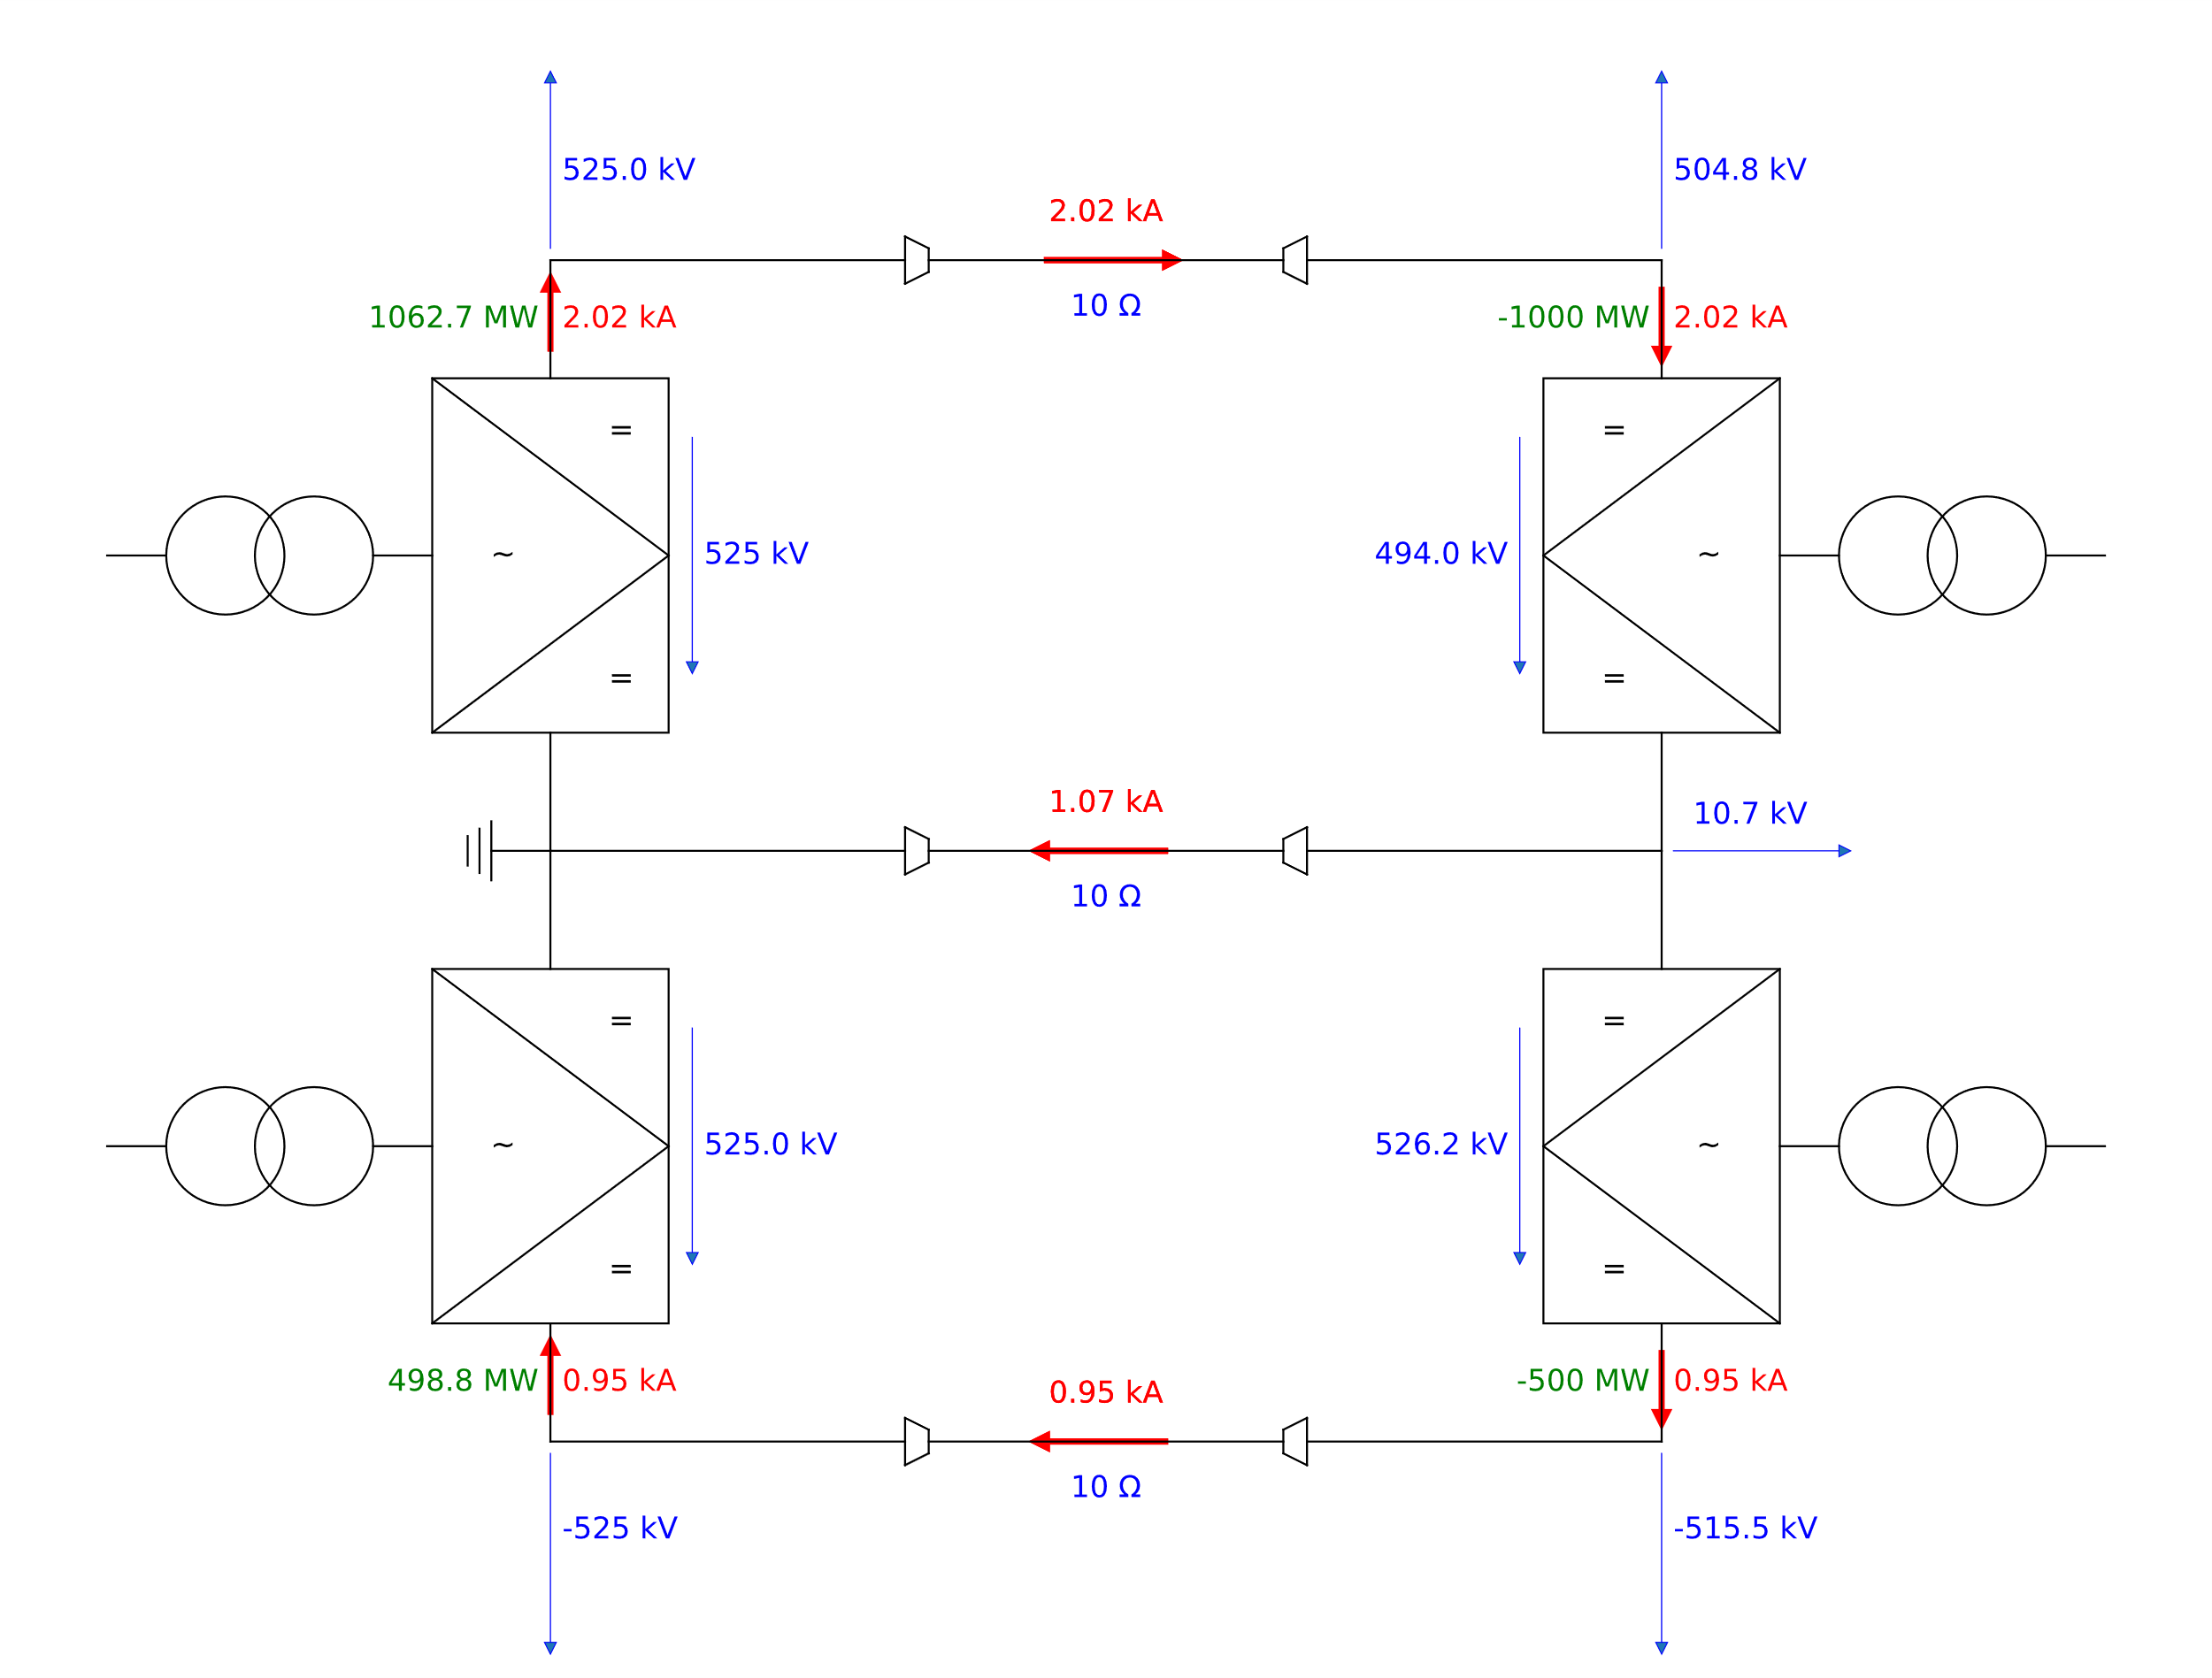
Balanced vs. Unbalanced Operation
Balanced Mode
Unbalanced Mode

Slide 15
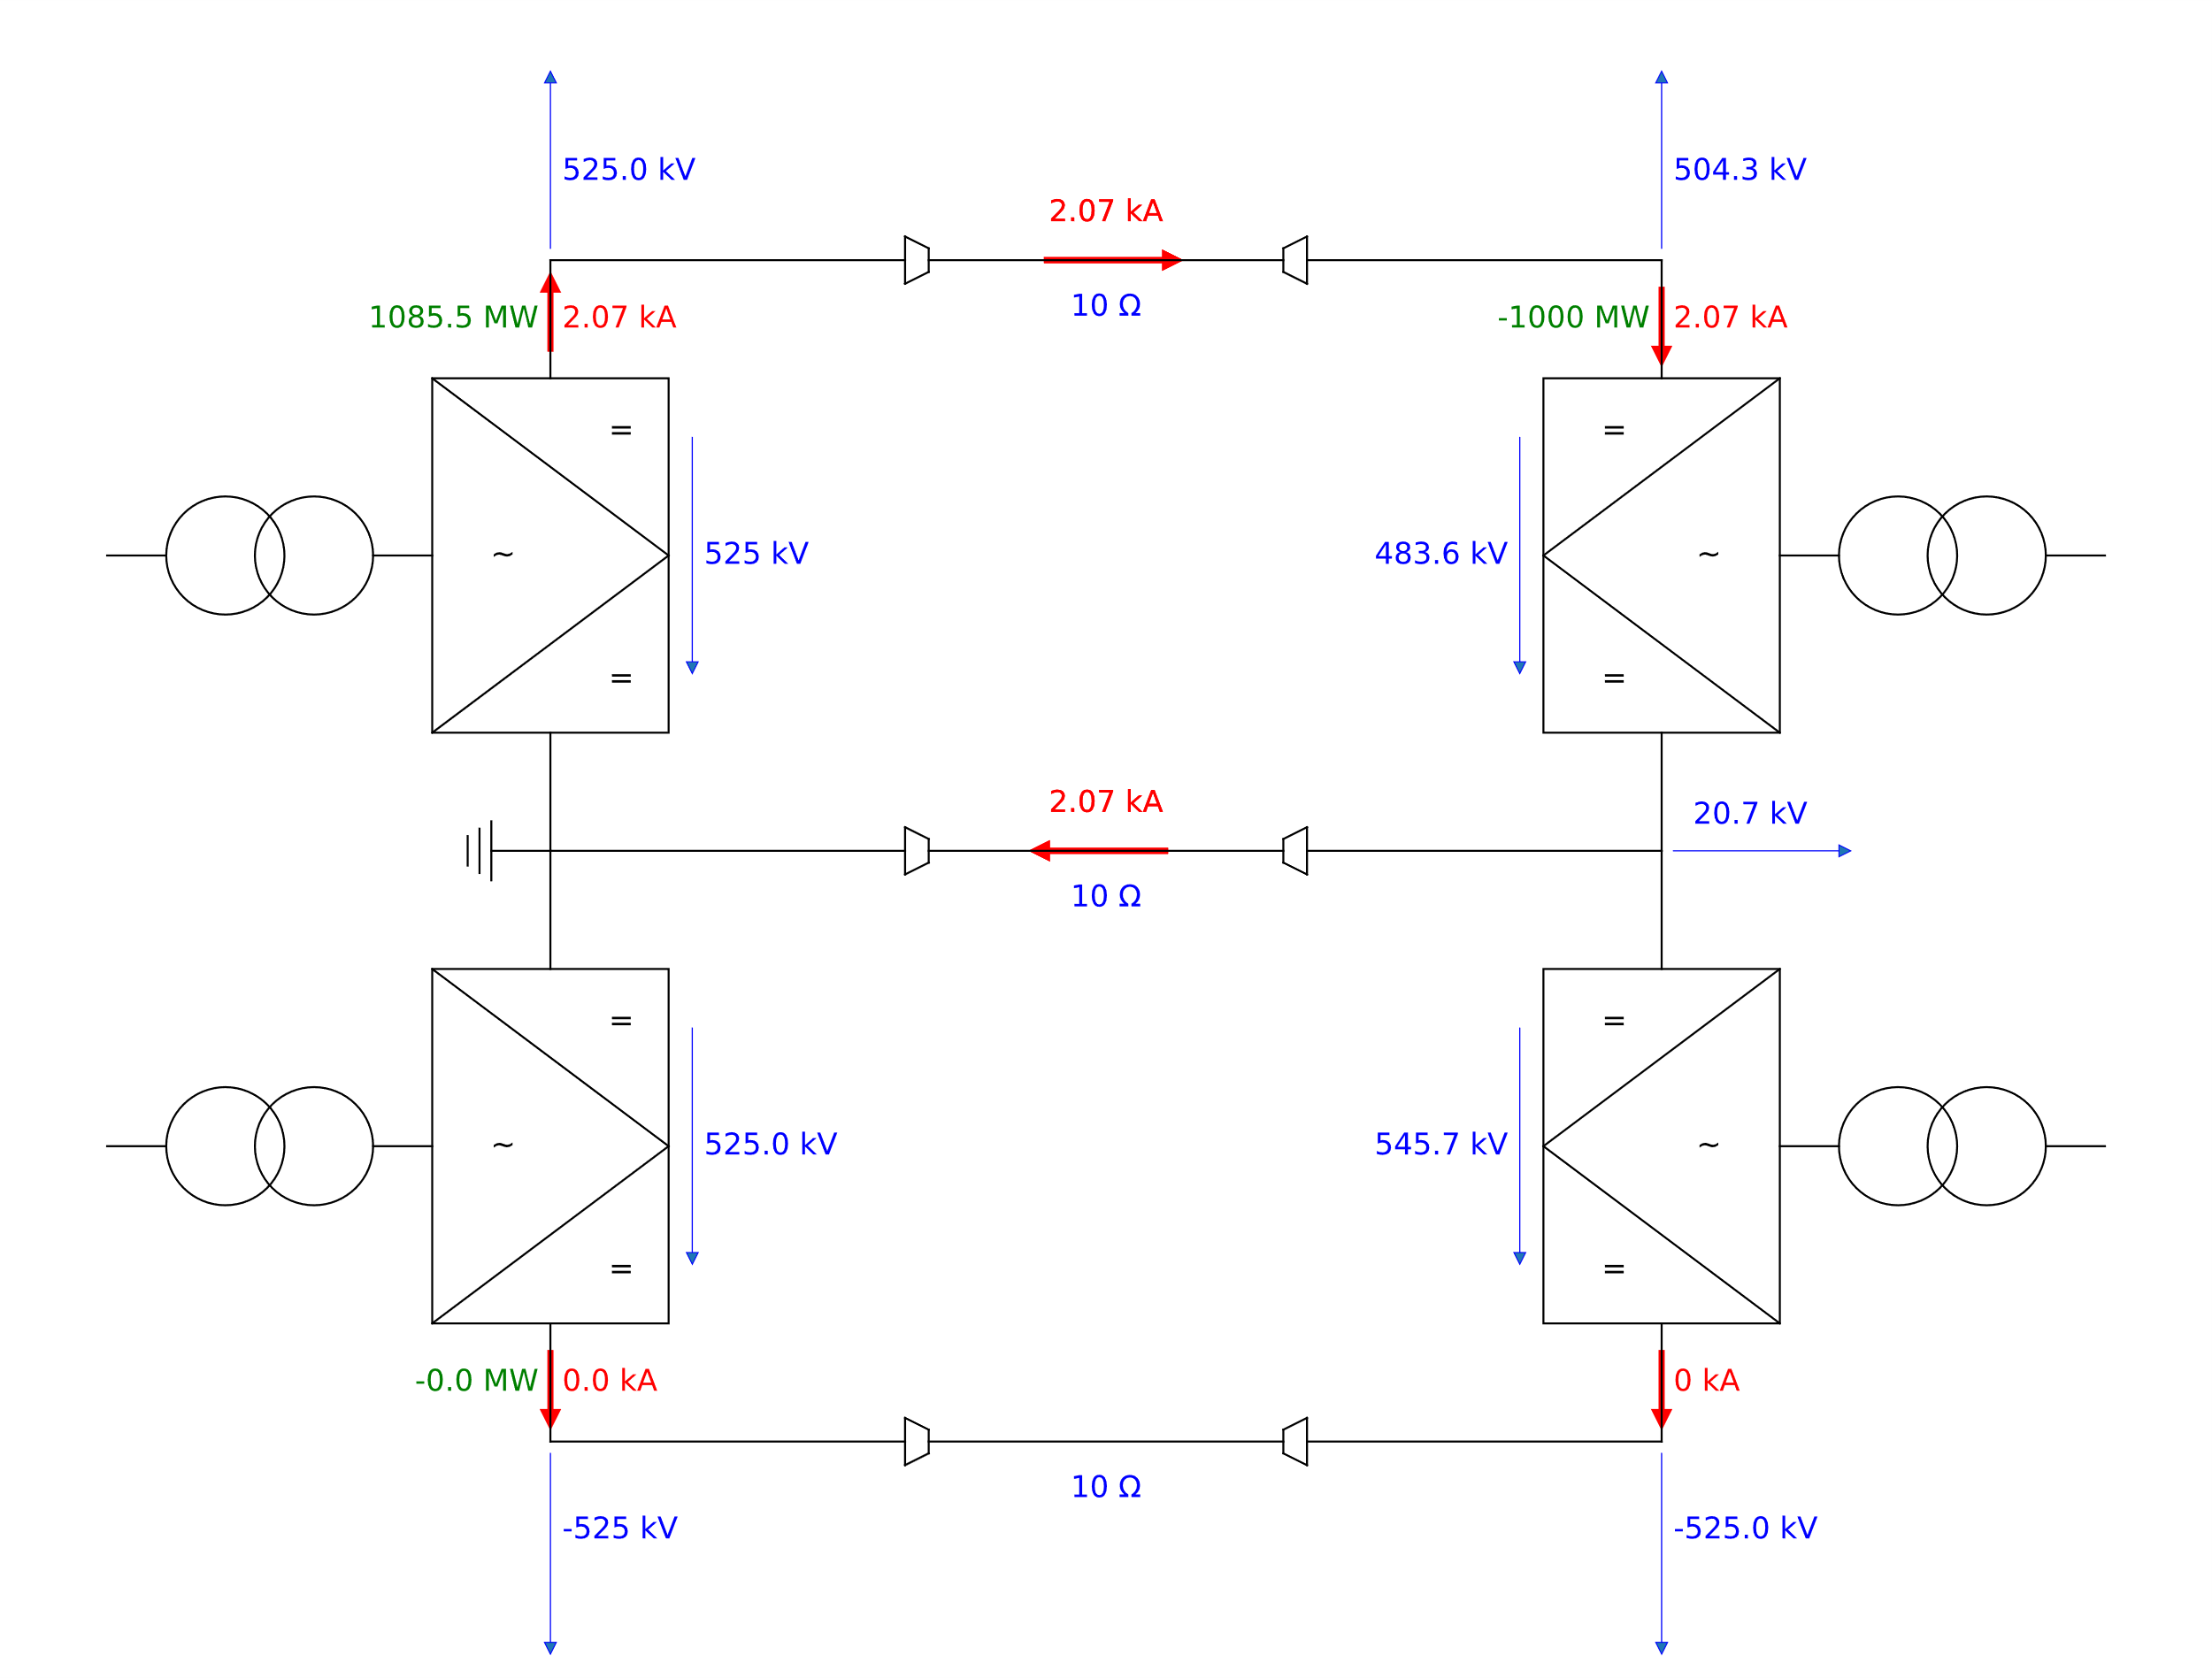
Monopolar operation
Monopolar operation is usually for a short period of time till the reconfiguration of the system is finished
If longer operation time is required, DMR needs to be designed accordingly

Slide 16
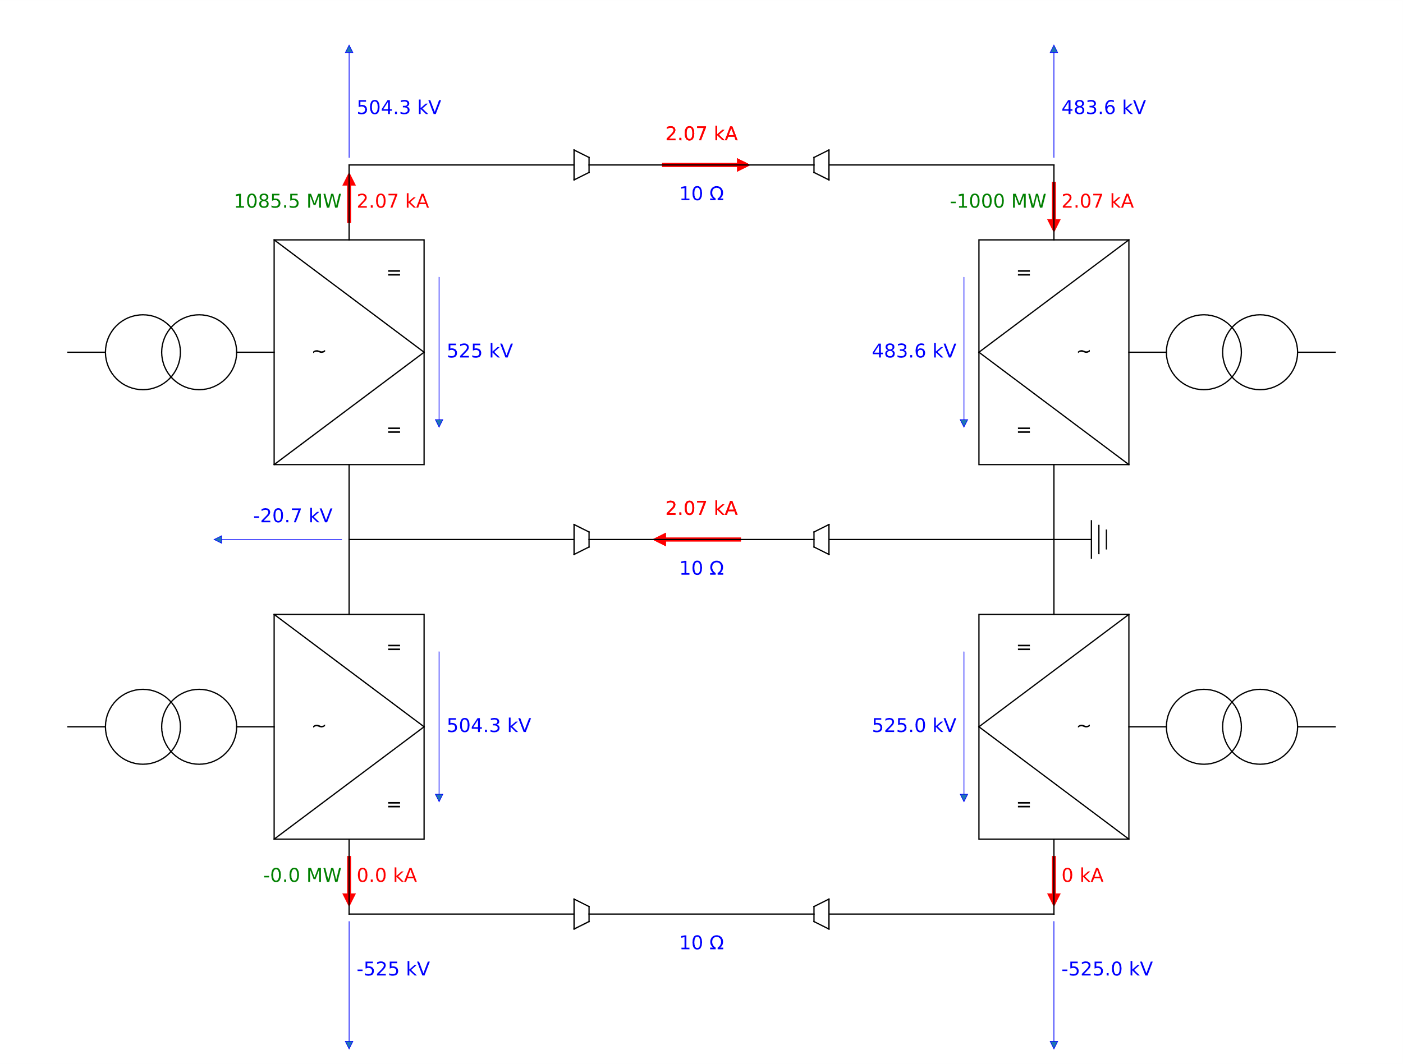
System Earthing
Earthing of the BIP system has no impact on the resulting currents and losses

Slide 17
BIP → Rigid BIP
3 conductors with 2 different types
Bipole consists of two-poles which can transmit the power independently
In case of a fault in one pole, the other pole can still transmit power providing redundancy in power transmission
In case of symmetrical operation (both poles transmit the same power), no current is flowing through the DMR

Slide 18
BIP → Rigid BIP
Bipole
Rigid Bipole

Slide 19
Rigid BIP
2 conductors of 1 type
Bipole consists of two-poles which have to transmit the same power because the same power is flowing through the both poles
In case of a fault in one pole, the other pole might not be able to transmit the power

Slide 20
Rigid BIP Operation Modes
Common-busbar operation
Standard operation mode
Split busbar operation
Poles must have the same power during all operating modes (also during dynamic operation)
Monopolar operation
Reconfiguration takes > 1s

Slide 21
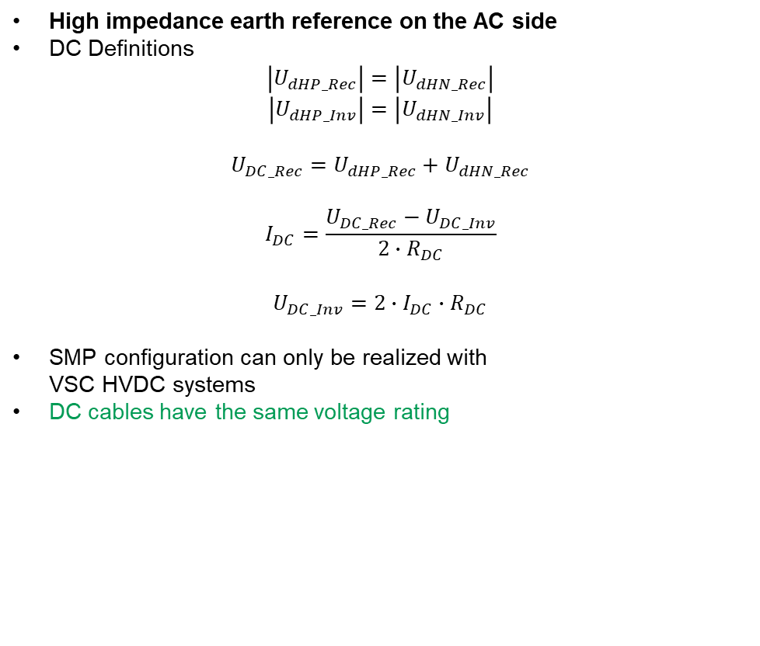
Symmetrical Monopole (SMP)
High impedance earth reference on the AC side
DC Definitions
$$\left|U_{dHP_Rec}\right|=\left|U_{dHN_Rec}\right|$$
$$\left|U_{dHP_Inv}\right|=\left|U_{dHN_Inv}\right|$$
$$U_{DC_Rec}=U_{dHP_Rec}+U_{dHN_Rec}$$
$$I_{DC}=\frac{U_{DC_Rec}−U_{DC_Inv}}{2∙R_{DC}}$$
$$U_{DC_Inv}={2∙I}_{DC}∙R_{DC}$$
SMP configuration can only be realized with VSC HVDC systems
DC cables have the same voltage rating

Slide 22
Modular Multilevel Converter (MMC)
Power transmission parameters
1000 MW
320kV maximum DC line voltage
1563A maximum current rating
 | 2 x Monopole | 1 x BIP | 1 x SMP
Transformers | -- | -- | ++
DC lines | -- 4 lines / 2 types 1563 A | - 3 lines / 2 types 1563 A | ++ 2 lines / 1 type 1563 A
Converters | - 4 Converters | - 4 Converters | + 2 Converters
Converter rating | + 320 kV | + 320 kV | -- 640 kV
Losses | -- | - | +
Reliability | ++ | + | --

Slide 23
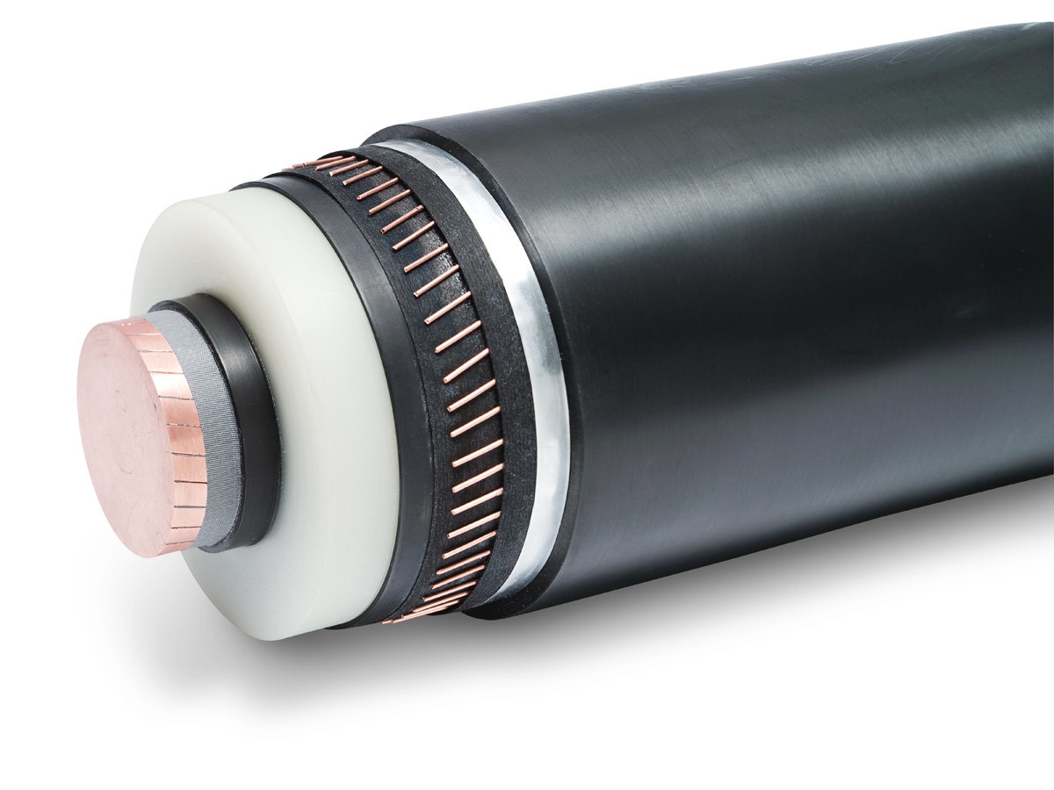
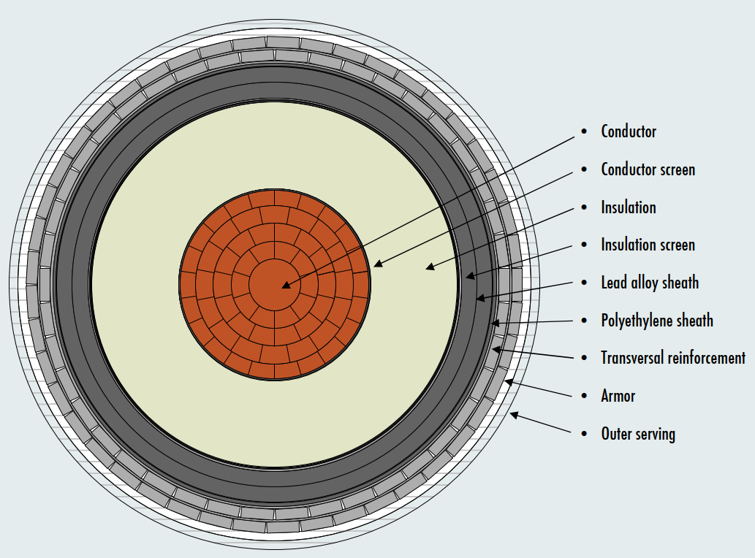
DC cable
Main elements of the DC cable are:
Insulator
XLPE: Cross-linked polyethylene
MI: Mass impregnated
Conductor
Copper
Aluminium
Balance between DC voltage and DC current for most economical design
Generally it can be assumed that Insulator is cheaper than the conductor → Higher voltage rating is preferred
Voltage levels in VSC-HVDC projects:
80 kV Projects up to 200MW power
200 kV TBC project voltage
250 kV Used in one project
320 kV Most common voltage
400 kV Cable voltage promoted by some cable suppliers due 525 kV New Standard for power applications ≥ 2000 MW
www.borealisgroup.com

Slide 24
Topology comparisson
 | Symmetric Monopole | Rigid Bipole | Bipole with Metallic Return
DC conductors | 2 | 2 | 3
Power transmission in case of converter fault | 0 % | 50 % | 50 %
Power transmission in case of DC conductor fault | 0 % | 0 % | 50 %
Economical DC voltage | ≤ 400 kV | > 500 kV | > 500 kV
Costs | $ | $$ | $$$
Max. Power | 1400 MW (320 kV) 1500 MW (400 kV) | 2000 MW | 3000 MW

